Slide 1

Selected Topics in Computational Intelligence I
Session Enrichment 6 –Guest Lecture
Face Recognation

Slide 2
Agenda
Introduction to computer vision
Face detection and recognition
Pattern Recognition
SIFT Keypoint Detector
AAM
OpenCV

Slide 3
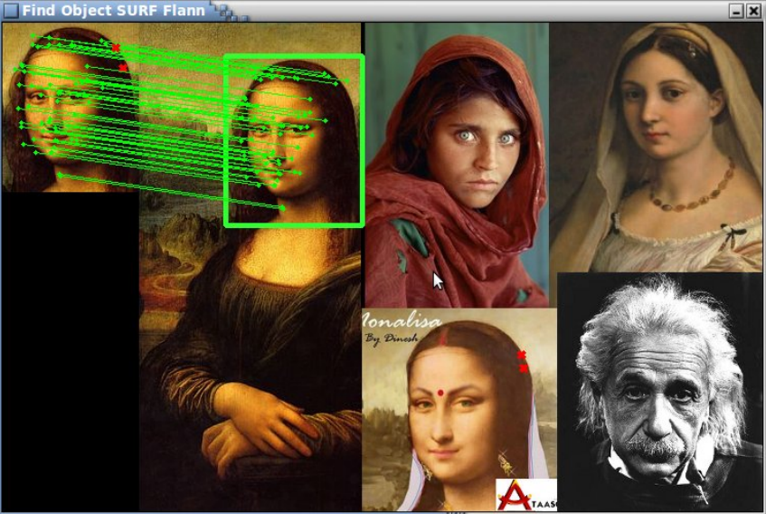
Face Recognition
Face recognition is both a popular and a difficult topic, and many researchers devote years to the field of face recognition

Slide 4
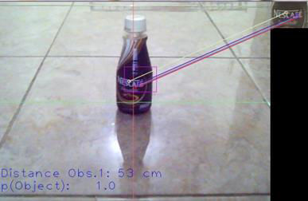
Pattern Recognition
The GOAL is to classify objects of interest into one of a number of categories or classes
Uses:
Many systems must recognize things and make decisions automatically
Every-day applications: Speech recognition, Fingerprint identification, DNA sequence identification, OCR (Optical Character Recognition)
Medical applications: diagnosis of symptoms, etc.
SIFT keypoint detector

Slide 5
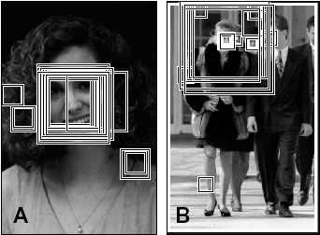
Classifiers for Recognition
Examine each window of an image
Classify object class within each window based on a training set images

Slide 6
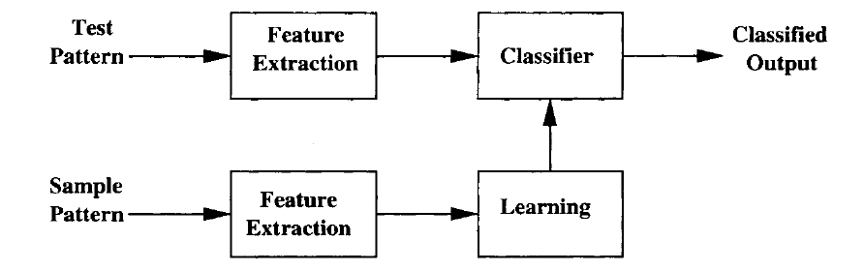
Supervised Learning
Off-Line Process

Slide 7
FaceRecognizer class
The Face Recognition algorithm can be one of these and perhaps more, depending on your version of OpenCV, which must be atleast v2.4 :
"FaceRecognizer.Eigenfaces": Eigenfaces, also referred to as PCA (Turk and Pentland, 1991).
"FaceRecognizer.Fisherfaces": Fisherfaces, also referred to as LDA (Belhumeur et al, 1997).
"FaceRecognizer.LBPH": Local Binary Pattern Histograms (Ahonen et al, 2006).
const char *facerecAlgorithm = "FaceRecognizer.Fisherfaces";

Slide 8
Cascade Classifier
Cascade Classifier file, used for Face Detection.
const char *faceCascadeFilename =
"lbpcascade_frontalface.xml"; // LBP face detector.
const char *eyeCascadeFilename1 = "haarcascade_eye.xml";
// Basic eye detector for open eyes only.
const char *eyeCascadeFilename2 = "haarcascade_eye_tree_eyeglasses.xml"; // Basic eye detector for open eyes if they might wear glasses.

Slide 9
3D Pose Estimation
• Active Appearance Model (AAM): An object model containing statistical information of its shape and texture. It is a powerful way of capturing shape and texture variation from objects.
• Active Shape Model (ASM): A statistical model of the shape of an object. It is very useful for learning shape variation.
- Pose from Orthography and Scaling with Iterations (POSIT): A computer vision algorithm that performs 3D pose estimation.

Slide 10
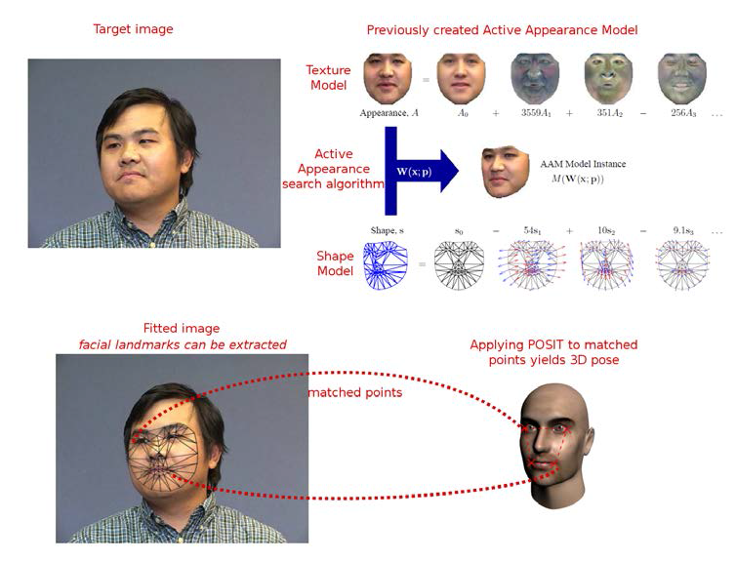
Active Appearance Model (AAM)
Given an image (upper-left image in the preceding screenshot), we can use an Active Appearance search algorithm to find the 2D pose of the human head.
The upper-right side figure in the screenshot shows a previously trained Active Appearance model used in the search algorithm. After a pose has been found, POSIT can be applied to extend the result to a 3D pose.

Slide 11
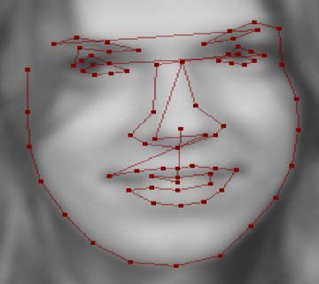
Active Shape Models
AAMs require a shape model, and this role is played by Active Shape Models (ASMs)
There are 76 landmarks on a face, which are taken from the MUCT dataset. These landmarks are usually marked up by hand and they outline several face features, such as mouth contour, nose, eyes, eyebrows, and face shape, since they are easier to track.

Slide 12
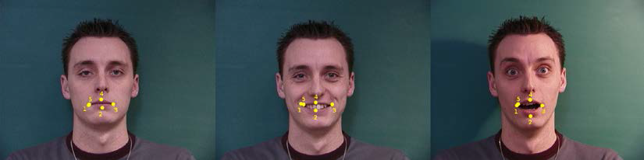
Active Appearance Models
The following screenshot shows point-annotated mouth landmarks for three different pictures:

Slide 13
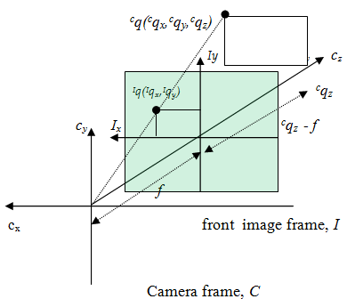
Stereo Vision
Point projection
Titik di kerangka image depan ^{I}q(^{I}q_{x},^{I}q_{y}) merupakan proyeksi titik pada kerangka kamera ^{C}q(^{C}q_{x},^{C}q_{y},^{C}q_{z}) ke kerangka image depan, dimana f melambangkan focal length.

Slide 14
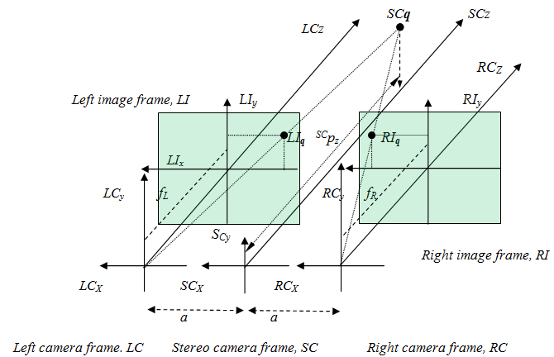
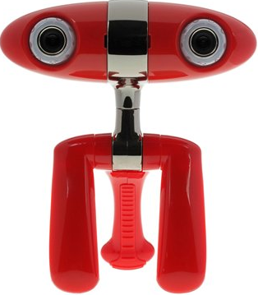
Stereo Model
Titik 3 dimensi pada kerangka kamera stereo dapat direkonstruksi menggunakan proyeksi titik 2 dimensi dari kerangka image kanan dan kiri

Slide 15
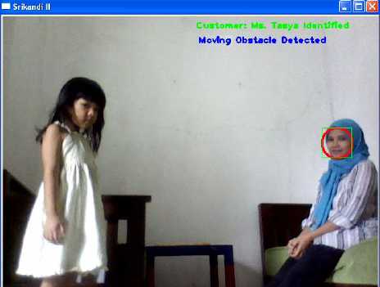
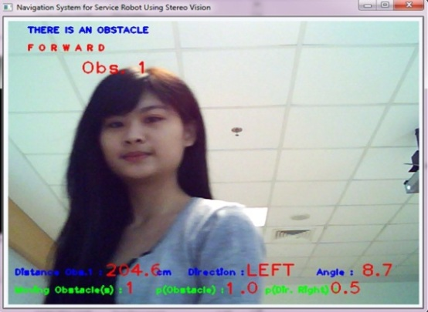
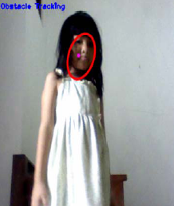
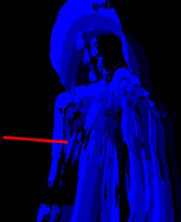
Motion History

Slide 16
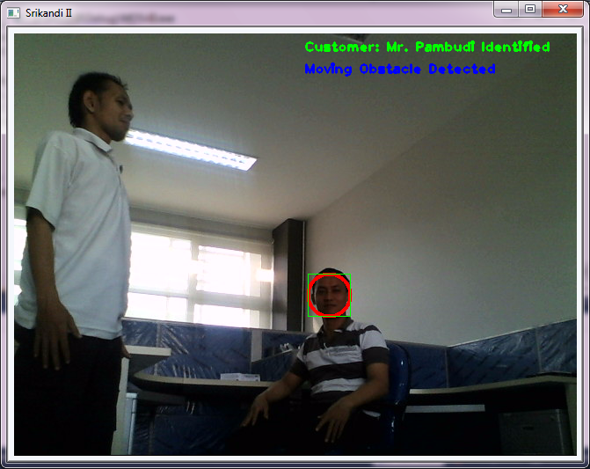
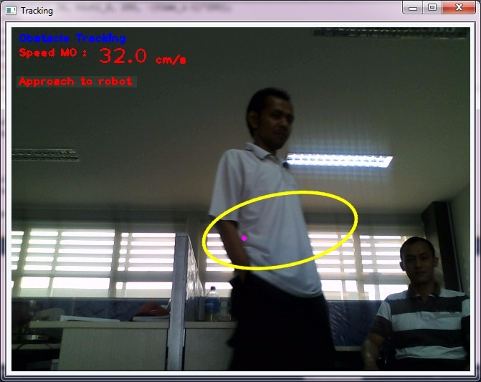
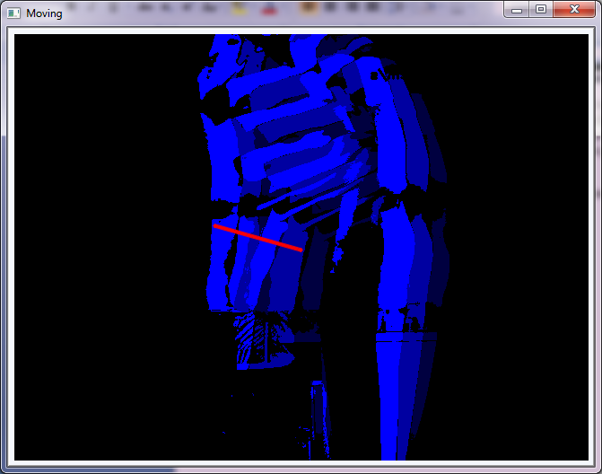
Tracking
dengan motion history
a)
b)
c)
Deteksi orang lewat dan arah gerak menggunakan motion history

Slide 17
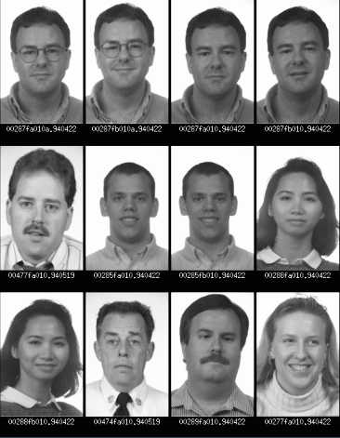
PCA
Training set of m images of size N*N are represented by vectors of size N²
x₁,x₂,x₃,…,x_{M}
Example

Slide 18
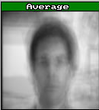
PCA
The average training set is defined by
μ= (1/m) ∑^{m}_{i=1} x_{i}
Each face differs from the average
r_{i} = x_{i} – μ

Slide 19
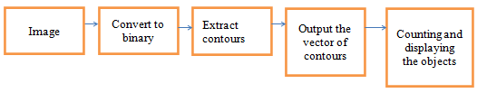
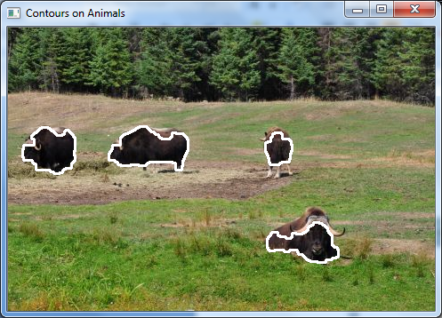
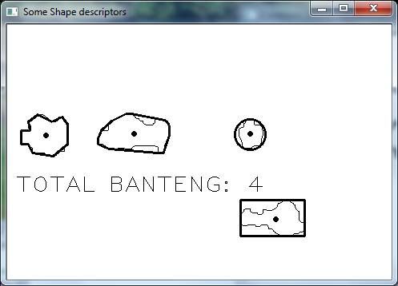
Object Counting
using contour

Slide 20
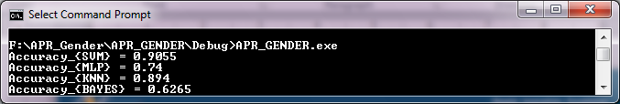
Machine Learning
OpenCV provides 5 ML methods:
CvANN_MLP mlp;
CvANN_MLP_TrainParams params;
CvTermCriteria criteria;
criteria.max_iter = 100;
criteria.epsilon = 0.00001f;
criteria.type = CV_TERMCRIT_ITER | CV_TERMCRIT_EPS;
params.train_method = CvANN_MLP_TrainParams::BACKPROP;
svm(trainingData, trainingClasses, testData, testClasses);
mlp(trainingData, trainingClasses, testData, testClasses);
knn(trainingData, trainingClasses, testData, testClasses, 3);
bayes(trainingData, trainingClasses, testData, testClasses);
decisiontree(trainingData, trainingClasses, testData, testClasses);

Slide 21
exercise
Create a realtime face recognition systems using LBP

Slide 22
References
Adries P. Engelbrect. (2007), Computational Intelligence An Introduction. 2nd ed. John Wiley & Sons. USA.
Peter Harington (2012), Machine Learning in Action, Manning Publisher, USA.
Widodo Budiharto (2014), Modern Robotics with OpenCV, SPG Publisher, USA.
Daniel Bagio et al (2012), Mastering OpenCV with Practical Computer Vision Projects, Pact Publisher.

Slide 23
Thank You

